Slide 1
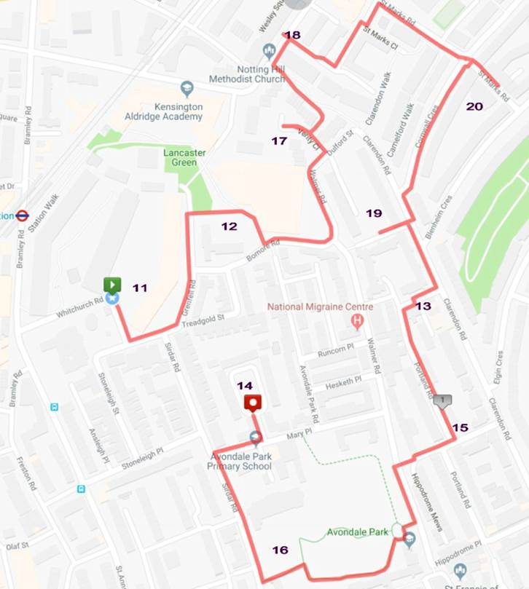
Site walkover/Recce Day 1
Thursday, 23 May 2018
Areas 11 to 20 (1.7 mile route)
Start Green and finish Red
11. Community area between Testerton Walk and Barandon Walk
12. Communal open space around Treadgold House
13. Community garden at Portland Road
14. Communal space at Avondale Park
15. Community garden at Portland Road
16. Avondale Park
17. Open space at Verity Close
18. Communal open space at Morland House
19. Communal open space at Allom House and Barlow House
20. Open space at The Grove
9.30am
10am
10.30am
11.am
11.30am
12pm
Lunch
13pm
13.30pm
14pm
14.30pm

Slide 2
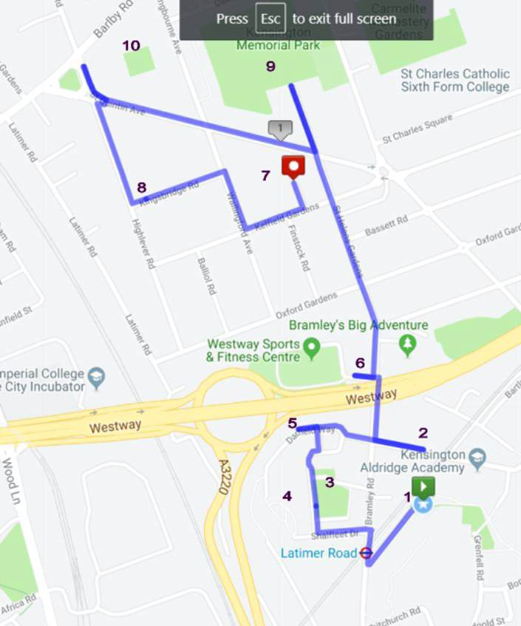
Site walkover/Recce Day 2
Friday, 24 May 2018
Areas 1- 10 (1.4-mile route)
Street Green and finish Red
1. Community area immediately to west of Tower
2. Communal open space at Whitstable House
3. Wayneflete Square
4. Communal open space at Markland House
5. Community garden areas along Darfield Way
6. Robinson House
7. St Quintin Gardens
8. 20 Kingsbridge Road community garden
9. Kensington Memorial Park (St Marks Park)
10. 10 - West London Bowling Club 10
9.30am
10am
10.30am
11.am
11.30am
12pm
Lunch
13pm
13.30pm
14pm
14.30pm

